Slide 1


PY-EXPO
2K24
Team ID:T043
Team Name:Cyber ﻿Wolves
Genius innovation leaves behind a legacy...
PYEXPO 2K24

Slide 2
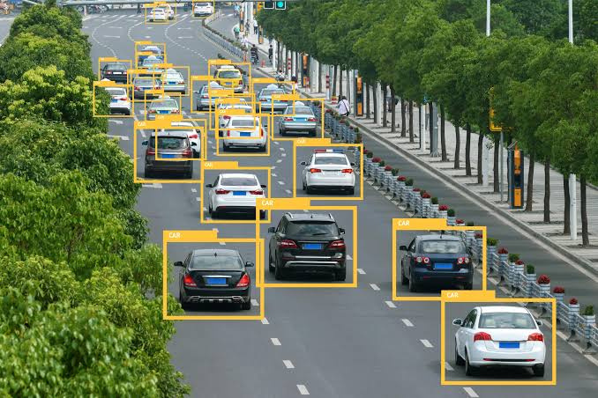
PS Code: py16
Problem Statement:
Vehicle Counting
&
Detection
PYEXPO 2K24

Slide 3
Solution
1.Simple counter:This method works for basic scenarios where you only need to Keep
track of the total vehicle count. It doesn't involve any image or video processing.
2.Computer Vision with OpenCV: This approach is more sophisticated and involves using OpenCV library for image processing and object detection. You can train an object detection model toidentify vehicles in a video stream and then count the number of detected vehicles.
Here's a general outline of the steps involved:
import necessary libraries (OpenCV, etc.)Load the video or configure the camera for live feed.
Pre-process the video frames (resizing, filtering).Use a pre-trained object detection model
(YOLO, etc.) to identify vehicles in each frame.Implement logic to track and count the
detected vehicles(avoid double counting).Display the results (optional).
PYEXPO 2K24

Slide 4
Technology stacks
_________________ _________
Technology stacks used
✿. Python
Packages:
✿. OpenCV
✿. OS
✿. Numpy
PYEXPO 2K24

Slide 5
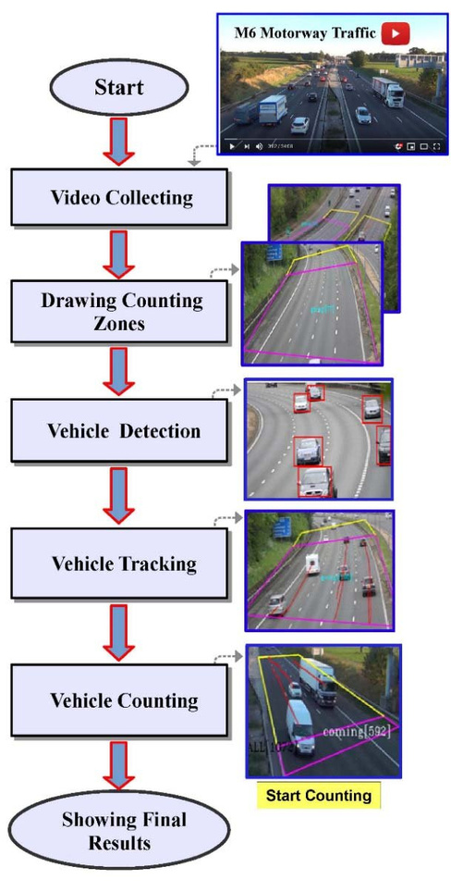
Flow Chart:

Slide 6
Team Member Details:
✿.Arun kumar. P
✿. Gokul priyan.S
✿. Devan dhivakar.B
✿. Kabilanban.D
✿. Vikash.R
PYEXPO 2K24

Slide 7

Thank You
Any Queries?
PYEXPO 2K24

